Slide 1

ANFIS BASED SVC FOR WIND-INTEGRATED POWER SYSTEM TO ENHANCE VOLTAGE STABILITY AND LVRT CAPABILITY
ELECTRICAL POWER SYSTEMS
Department of Electrical & Electronics Engineering
Presented by Under the Guidance of
C.NIRMALA Dr .K .Jithendra Gowd (18001D2112) Assistant Professor,EEE

Slide 2
CONTENTS
INTRODUCTION
OBJECTIVE
EXISTING METHOD
BLOCK DIAGRAM
SIMULATON RESULTS
SYATEM PARAMETERS
REFERENCES

Slide 3
INTRODUCTION
Wind energy is among the fastest growing Renewable Energy Resources
So its stability,reliability and safety have been significant in recent years
Wind generations should be able to satisfy grid code requirements when connecting to the network.
GCR consist of two sections a)static and b)dynamic .
SVC is a static var absorber or generator.
The output of which is adjusted to exchange inductive or capacitive current to control or maintain specific parameters of power systems.

Slide 4
The static section reviews the steady state performance of the system like frequency and voltage regulation, and reactive and active power control.
The dynamic section is related to the system performance under fault situations and disturbances.
The most important subject reviewed in the dynamic section of grid codes with respect to the wind power is the low voltage ride-through (LVRT) capability.

Slide 5
Objectives
To improve the SVC(Static Var Compensator) performance
To enhance LVRT capability of wind farm.
To enhance the stability of the system
To improve the accuracy and performance in both transient and steady state

Slide 6
The overall schematic of the test system.

Slide 7
EXISTING METHOD
To improve the SVC performance, its conventional control system has been modified using intelligent systems.
In order to enhance the SVC performance in voltage stabilization, an auxiliary control signal is added to the SVC controller.
This auxiliary control signal is generated using a fuzzy inference system (FIS).
This signal modifies the input of the transfer function that generates the reference susceptance and by adding a supplementary voltage control to the controller leads to the enhancing the control system accuracy in generating the reference susceptance of the SVC.

Slide 8
The SVC is employed with a Fuzzy Logic Controller to improve the voltage stability of the system and the Low Voltage Ride Through (LVRT) capability of the wind farm.
The main drawback of the system is Voltage collapse,Chaotic oscillations presents in the power system.

Slide 9
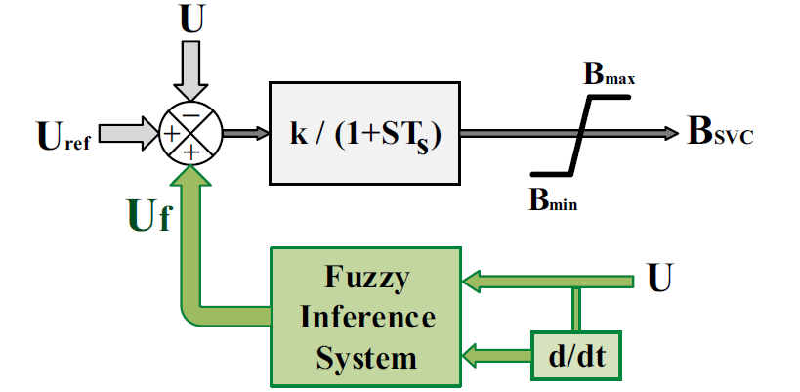
The schematic of the existing system

Slide 10
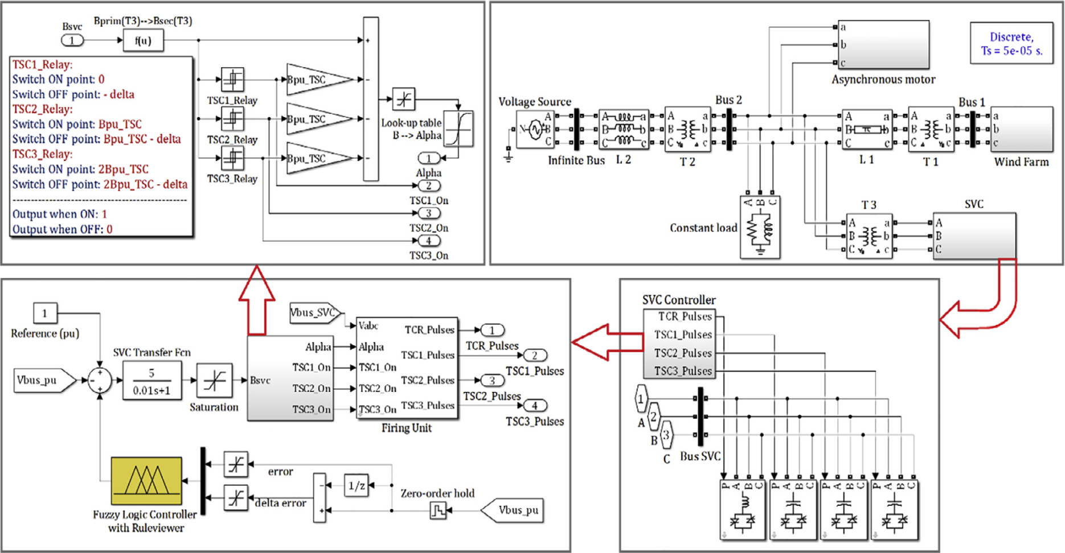
The simulink block diagram of the system

Slide 11
The different values of the constant load in the simulated system.
 | P(p.u) | Q(p.u)
LOAD 1 | 0.9 | 1.5
LOAD2 | 0.9 | 3.0
LOAD 3 | 0.9 | 4.0

Slide 12
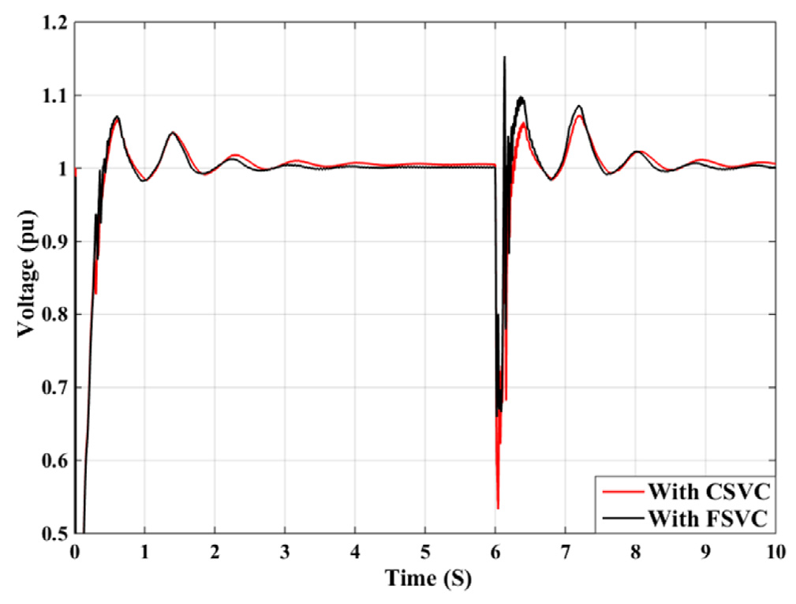
Voltage of bus 2 using CSVC and FSVC; (a) with load 1,

Slide 13
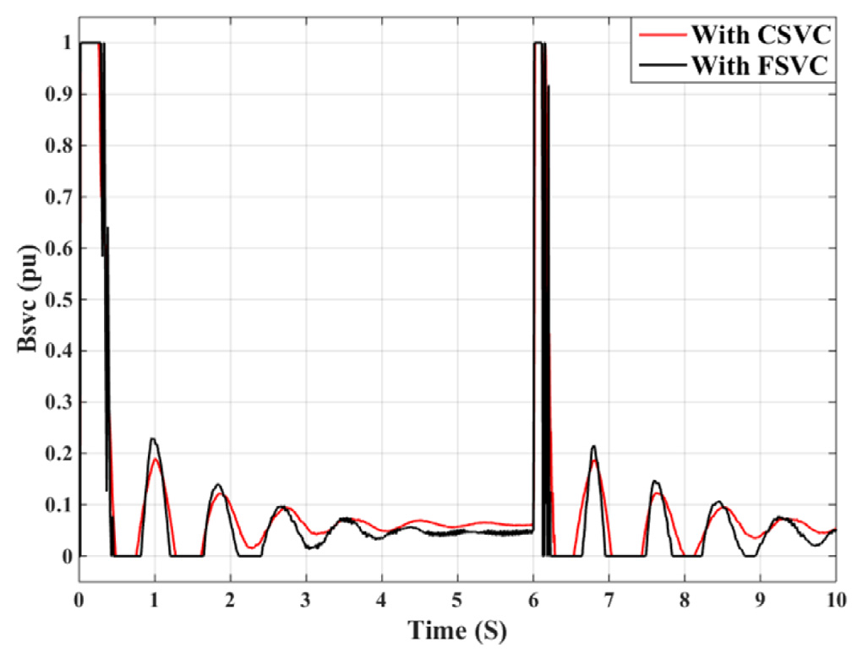
The reference susceptance of CSVC and FSVC; (a) with load 1

Slide 14
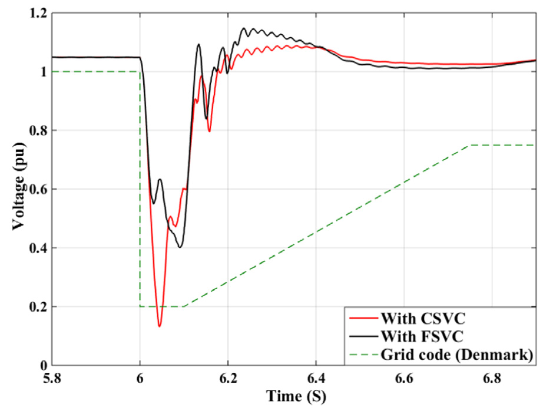
Voltage of bus 1 using CSVC and FSVC; (a) with load 1,

Slide 15
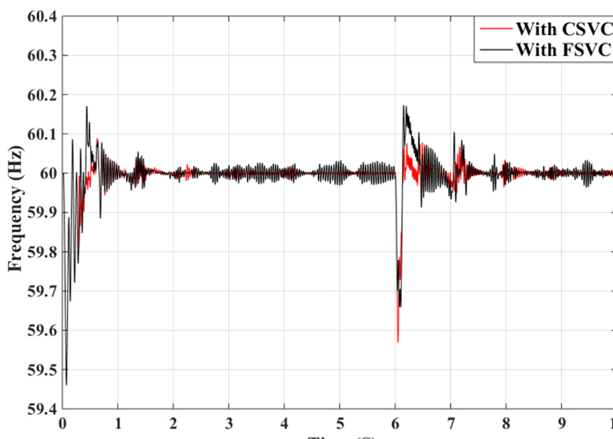
System frequency measured at bus 2 while using CSVC and FSVC; (a) with
load 1,

Slide 16
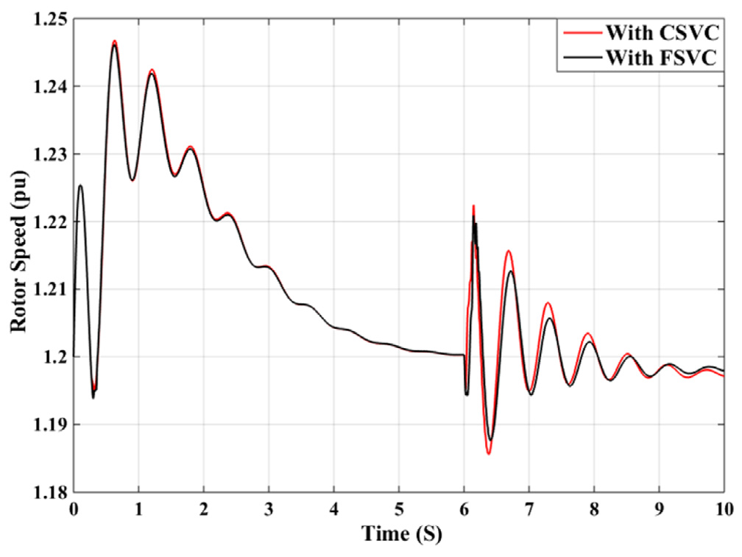
The DFIG rotor speed using CSVC and FSVC; (a) with load 1

Slide 17
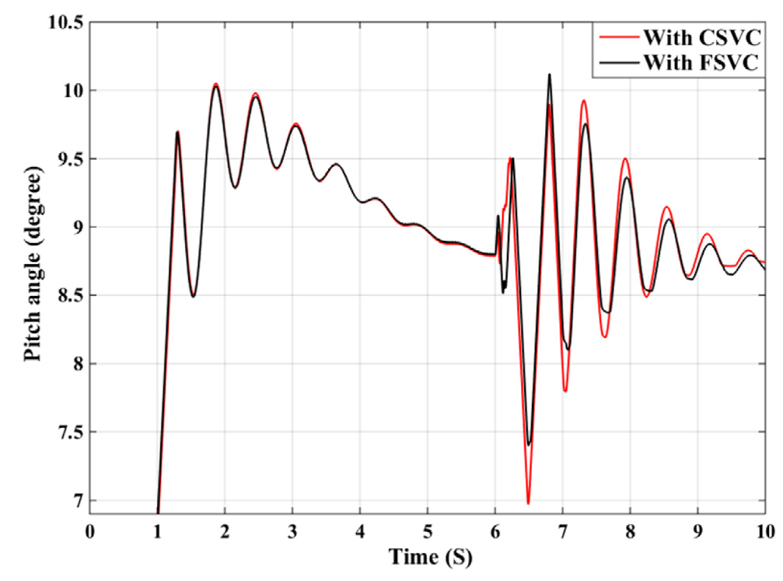
The blade pitch angle using CSVC and FSVC; (a) with load 1.

Slide 18
Appendix 2. Test system parameters
System base parameters: Base power (MVA) 10 Base frequency (Hz) 60 Base angular frequency (rad/s) 120p DFIG-based wind farm Number of wind turbines 6 Generators parameters Nominal power (MVA) 1.667 Nominal stator voltage (Vrms) 575 Nominal rotor voltage (Vrms) 1975 Stator resistance (pu) 0.023 Stator inductance (pu) 0.18 rotor resistance (pu) 0.016 rotor inductance (pu) 0.16 Magnetizing inductance (pu) 2.9 Inertia constant (S) 0.685 Friction factor (pu) 0.01

Slide 19
Turbines parameters Nominal mechanical output power (MW) 1.5 Wind speed at nominal speed and at Cp max (m/s) 11 Maximum pitch angle (deg) 27 Maximum rate of change of pitch angle (deg/s) 10

Slide 20
T1 Winding primary connection D 11 Winding secondary connection Yg Nominal power (MVA) 10.5 Primary phase to phase voltage (kVrms) 25 Primary resistance (pu) 0.0008 Primary inductance (pu) 0.025 Secondary phase to phase voltage (kVrms) 0.575 Secondary resistance (pu) 0.0008 Secondary inductance (pu) 0.025 | T2 Winding primary connection Yg Winding secondary connection D 1 Nominal power (MVA) 47 Primary phase to phase voltage (kVrms) 120 Primary resistance (pu) 0.0027 Primary inductance (pu) 0.08 Secondary phase to phase voltage (kVrms) 25 Secondary resistance (pu) 0.0027 Secondary inductance (pu) 0.08 | T3 Winding primary connection Yg Winding secondary connection D 1 Nominal power (MVA) 50 Primary phase to phase voltage (kVrms) 25 Primary resistance (pu) 0.0025 Primary inductance (pu) 0.105 Secondary phase to phase voltage (kVrms) 16 Secondary resistance (pu) 0.0025 Secondary inductance (pu) 0.045

Slide 21
L1 Positive sequence resistance (X) 3.459 Positive sequence inductance (H) 0.0315 Positive sequence capacitance (mF) 0.3399 Zero sequence resistance (X) 12.39 Zero sequence inductance (H) 0.0996 Zero sequence capacitance (mF) 0.1503 | L2 Positive sequence resistance (X) 0.576 Positive sequence inductance (H) 0.0153 Positive sequence capacitance (mF) 0 Zero sequence resistance (X) 17.28 Zero sequence inductance (H) 0.0458 Zero sequence capacitance (mF) 0

Slide 22
Asynchronous motor (ASM) Nominal power (MVA) 16.785 Nominal stator voltage (kVrms) 25 Stator resistance (X) 0.029 Stator inductance (H) 0.599 rotor resistance (X) 0.022 rotor inductance (H) 0.599 Mutual inductance (H) 0.034 Inertia (kg.m2) 63.87 Rotor type Squirrelcage

Slide 23
SVC SVC gain k 5 SVC time constant Ts 0.01 Bmin 0 Bmax 1

Slide 24
PROPOSED SYSTEM
An Adaptive Neuro Fuzzy Logic Controlle (ANFIS) has been added to the SVC controller
It integrates both neural network and fuzzy logic principles.
Is used for improving the voltage stability of the system as well as enhancing the LVRT capability of the wind farm.
This will enables the SVC to control the voltage collapse and chaotic oscillations of the power system
The SVC unit employed consists of three TSC parts and one TCR part.

Slide 25
PROPOSED SYSTEM
An Adaptive Neuro Fuzzy Logic Controlle (ANFIS) has been added to the SVC controller
It integrates both neural network and fuzzy logic principles.
Is used for improving the voltage stability of the system as well as enhancing the LVRT capability of the wind farm.
This will enables the SVC to control the voltage collapse and chaotic oscillations of the power system
The SVC unit employed consists of three TSC parts and one TCR part.

Slide 26
Conclusion:
The SVC performance in this test system is enhanced by integrating a proposed FIS to the SVC controller.
In the proposed method, an auxiliary control signal generated by the proposed FC is added to the conventional control system of the SVC that leads to the decreasing the steady state voltage error and the maximum voltage drop after the fault occurrence.
Because of the less voltage drop under the fault situation using the proposed FC for the SVC, the LVRT capability of the wind farm is improved and the system capability to meet the GCRs is enhanced.
The effectiveness of the suggested control technique is confirmed and its effect on the behavior of the DFIG-based wind turbine is investigated using system simulations in MATLAB/Simulink.

Slide 27
References
H. Rezaie, S.M.M. Chashmi, M. Mirsalim, H. Rastegar, Enhancing LVRT capability and smoothing power fluctuations of a DFIG-based wind farm in a DC microgrid, Electr. Power Compon. Syst. 45 (10) (2017) 88–95.
T. Hiyama, M. Mishiro, H. Kihara, et al., Fuzzy logic switching of thyristor controlled braking resistor considering coordination with SVC, IEEE Trans.Power Delivery 10 (4) (1995) 2020–2026.
B. Changaroon, S.C. Srivastava, D. Thukaram, et al., Neural network based power system damping controller for SVC, IET, IEE Proc. Gener. Transm.Distrib. 146 (4) (1999) 370–376
D.Z. Fang, Y. Xiaodong, T.S. Chung, et al., Adaptive fuzzy-logic SVC damping controller using strategy of oscillation energy descent, IEEE Trans. Power Syst.19 (3) (2004) 1414–1421.
L. Wang, D.N. Truong, Stability enhancement of a power system with a PMSGbased and a DFIG-based offshore wind farm using a SVC with an adaptivenetwork- based fuzzy inference system, IEEE Trans. Ind. Electron. 60 (7) (2013) 2799–2807.
I.M. Ginarsa, A. Soeprijanto, M.H. Purnomo, Controlling chaos and voltage collapse using an ANFIS-based composite controller-static var compensator in power systems, Elsevier Int. J. Electr. Power Energy Syst. 46(2013) 79–88.

Slide 28


